Slide 1
ADMINS ONLY
Delete this slide before you share the kit
This kit is a starting point. Before you send it out, make a few quick edits so it matches how your team uses HeyTaco.
01
Pick your platform. This kit works for Slack or Microsoft Teams — cut whichever doesn't apply. The "Slack extras" slide is Slack-only; delete it if you're on Teams.
02
Reactions off in Slack? Remove the reactions half of the "Slack extras" slide.
03
Not using Stickers? Remove the stickers half of that same slide.
04
Using Values tags? On "What tacos are for," swap the placeholder for your real ones — #teamwork, #ownership, #customerfirst.
05
No Rewards or Taco Shop? Drop "and can unlock rewards" on "What is HeyTaco?" and "may be redeemable for rewards" on "The Basics."
06
Update the admins. Swap "your workspace admin" for the names of your HeyTaco admins.
Once you've made these calls, delete this slide — it's not part of the new-hire kit.
Notes:
Admins only. Make the six edits, then delete this slide before sharing the kit.

Slide 2
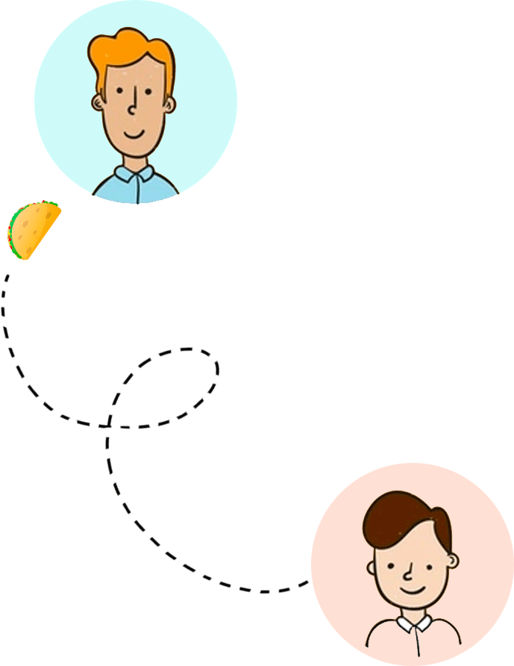

Welcome to the
Taco Economy 🌮
Your new-hire guide to giving (and getting) recognition.
Notes:
Set the tone: this is the fun part of onboarding. Five tacos a day, starting today.

Slide 3
01
What is HeyTaco?
02
The basics
03
How to give a taco
04
What tacos are for
05
Taco troubleshooting
What's inside
06
Your first taco challenge
Six stops. Ten minutes, tops.
Notes:
Quick roadmap. Six short stops, about ten minutes total.

Slide 4
What is HeyTaco?
🌮
A peer recognition tool that lives right inside Slack or Microsoft Teams — no new app to log into.
1
2
3
Everyone gets 5 tacos a day to give away.
Tag a teammate, add 🌮, and say why.
Tacos show up on leaderboards — and can unlock rewards.
No extra logins. Just gratitude, right where you already work.
03
Notes:
The one-sentence version: recognition that lives where you already work. Five tacos a day, every day.

Slide 5
The basics
Two simple motions. That's the whole system.
01 — GIVE
02 — GET
Giving a taco 🤙
Getting a taco 🎉
You start each day with 5 tacos.
Tag a teammate, add 🌮, and tell them why.
Every taco you receive shows up in your activity feed and on the leaderboard.
5
tacos a day, reset at midnight — use 'em or lose 'em.
∞
no cap on what you can receive — and they may be redeemable for rewards.
04
Notes:
Two motions only: give and get. Call out the midnight reset — tacos don't roll over.

Slide 6
How to give a taco
Una Japundza
10:38 AM
@Jordan thanks for jumping on that client call last minute! 🌮
Tag someone, write why, add 🌮 — that's it.
That's it — Jordan just got a taco, and everyone in the channel saw it.
Tagging more than one person? Everyone mentioned gets the full number of tacos in your message — it's not split between them. One 🌮 tagging two people means each person gets 1 taco; two 🌮🌮 means each gets 2.
Una Japundza
11:11 AM
@Ross @Joey awesome work on the sales call! 🌮
Ross and Joey each get 1 taco — the full amount in the message goes to everyone tagged, not divided up.
React to a message with 🌮 to give credit instantly.
05
Notes:
Show the message. One line, one taco, done. The math question always comes up: tacos aren't split between people tagged — everyone gets the full number.

Slide 7
Slack extras
A couple of Slack-only ways to spread the love.
Taco reactions 🌮
Stickers 🎨
React to any message with the 🌮 emoji and HeyTaco gives a taco to whoever's tagged in it. Tag more than one person? Everyone tagged gets a taco (as long as you've got enough left to give). No one tagged? The taco goes to whoever wrote the message — unless that's you.
Send a HeyTaco sticker to react or celebrate a win — browse and send them from the Stickers tab in the HeyTaco app.
Admin note: Slack-only — delete this slide if you're on Teams, or remove the Stickers half if you don't use it.
06
Notes:
Slack-only slide. Delete it for Teams, or trim whichever half you don't use.

Slide 8
Any win, big or small
What tacos are for
Landed the client or untangled a scheduling mess — it all counts.
Living our values
Someone modeled what we stand for? Tag it, so it sticks.
Be specific.
#teamwork
#ownership
#customerfirst
"Thanks for the help" is nice. "Thanks for staying late to fix checkout before launch" is a taco people remember.
Helping a teammate
Jumped in outside your role or team? That's exactly what tacos are for.
Notes:
The specificity point is the whole slide. Read both examples out loud — the difference lands.

Slide 9
Taco troubleshooting
Taco didn't land? It's almost always one of these.
No display name
Your message has to @mention them by name, not just describe them.
Edited after sending
HeyTaco only reads the original message. Edits don't count.
Still stuck?
Reach out to your HeyTaco Admins or email us at support@heytaco.com.
Over your daily limit
Tacos multiply. Tag 3 people with 🌮🌮🌮 and that's 9 tacos — more than your daily 5, so it won't go through.
Wrong channel
HeyTaco has to be in the channel where the taco was given.
08
Notes:
Four things that quietly eat tacos. Most support tickets are one of these four.

Slide 10
🌮
YOUR FIRST TACO CHALLENGE
Your first 5 tacos are waiting. Go give one.
Notes:
The ask: give one taco before the end of the day. Don't overthink it.

